Slide 1
Temporary Route Plan for RD Building Due to Rework of Granite Flooring at Lobby Area

Slide 2
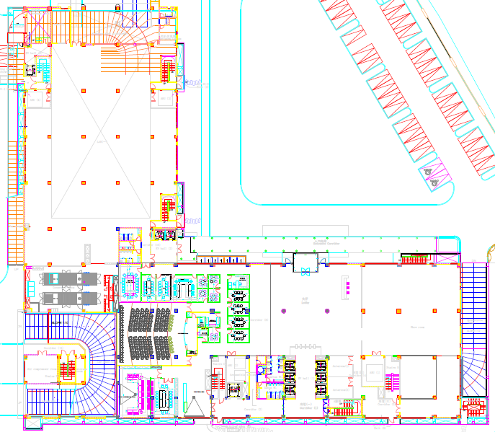
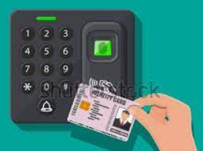
Temporary route plan for office floors
Attendance Punching machine location in MLCP
Way to follow Basement-1
Way to follow MLCP
Temporarily Isolated

Slide 3
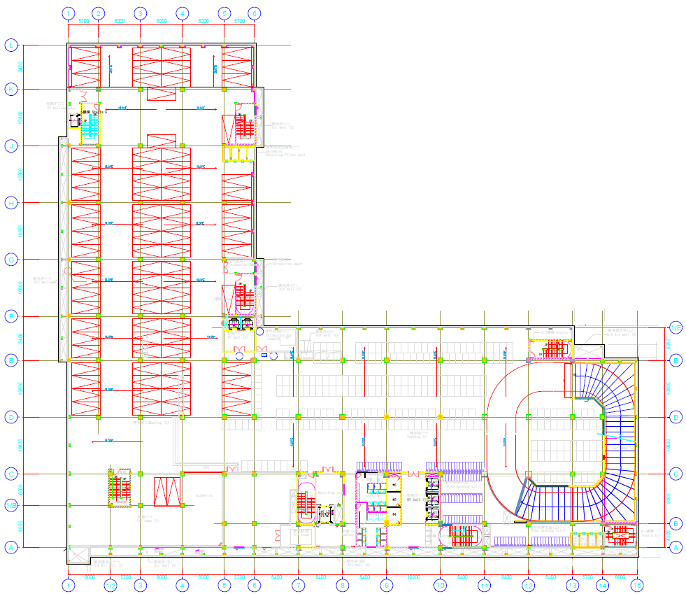
B1F Attendance Punching Machine
Way to Basement-1 for Lift lobby
Attendance Punching machine location in BF1
Temporary attendance machine location in B1F

Slide 4
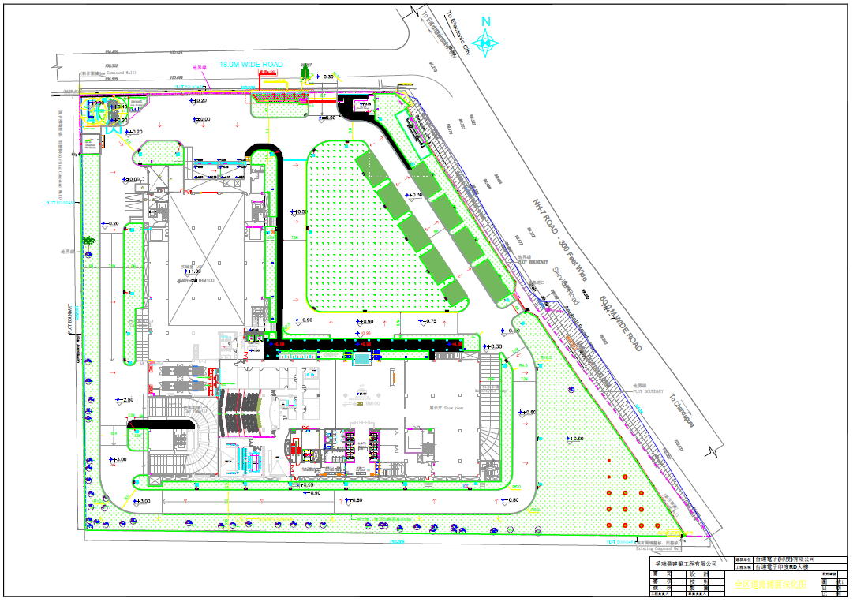
EMPLOYEES VEHICLE MOVEMENT
Main Gate
Exit B1F
Entry B1F
Remarks:- Employees vehicle movement will be remain same

